Slide 1
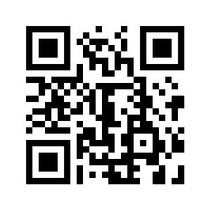


AUTOPEN
Innovate. Secure. Optimize.

Slide 2



Team Introduction
Joshua
Buscher
Documentation Specialist​
Prof. Akbas
Product
Owner
Michael Allen
Project Planner and Pentester​
Caleb Hall
Scrum Master and Pentester​
Calla Robison
Web Developer - Backend and Web Design ​
Myles Scott
Web Developer – Full Stack

Slide 3



What Is AutoPen
Automated Penetration Test Tool
Web-Hosted
Easy to Use

Slide 4




AutoPen's Mission
Distribute an online method for companies to easily test their own website vulnerabilities
A Safer Digital World through more accessible security
Empowering Organization Cybersecurity
through driving down testing costs
This Photo by Unknown Author is licensed under CC BY-NC

Slide 5
Summary of Requirements
User Interfaces
Hardware/Software
Communication
Software Interfaces:
Application hosted on Siteground's cloud server with 20 GB minimum storage.
Utilizes MySQL database, operates within Siteground's environment, compatible with Kali Linux VM.
Backend: Python Django Web Framework.
Frontend: React Web Framework.
Shared Data Mechanism:
Uses Django’s RESTful API backend and Axios HTTP request service frontend.
Integrates Burp Suite API for vulnerability and penetration testing.
Registration
Labeled Input Interfaces for Registration, Login, Profile, and Scanning
Scanning
Interface for Explained Scan Results
Business
Visual Interfaces for About Us, Contact Us, FAQ, Pricing
Functions
Accepts user credentials, target specifications, and configurations.
Generates test results and error messages.
Converts data from Burp Suite API to JSON format for manipulation and visualization.
Services
Utilizes Django RESTful API for frontend-backend communication.
Interface accessible across various devices

Slide 6


Web Development
Backend
Frontend
Python scripts for API calls
More secure
Database implementation
Allow for user accounts
Full login functionality
Database integration to Sitegrounds
React application upload to Sitegrounds
User Dashboard
Data chart visualization
System settings
User information
Refine Pages and features
Navigation Bar
About us
Login
Register
Landing Page

Slide 7

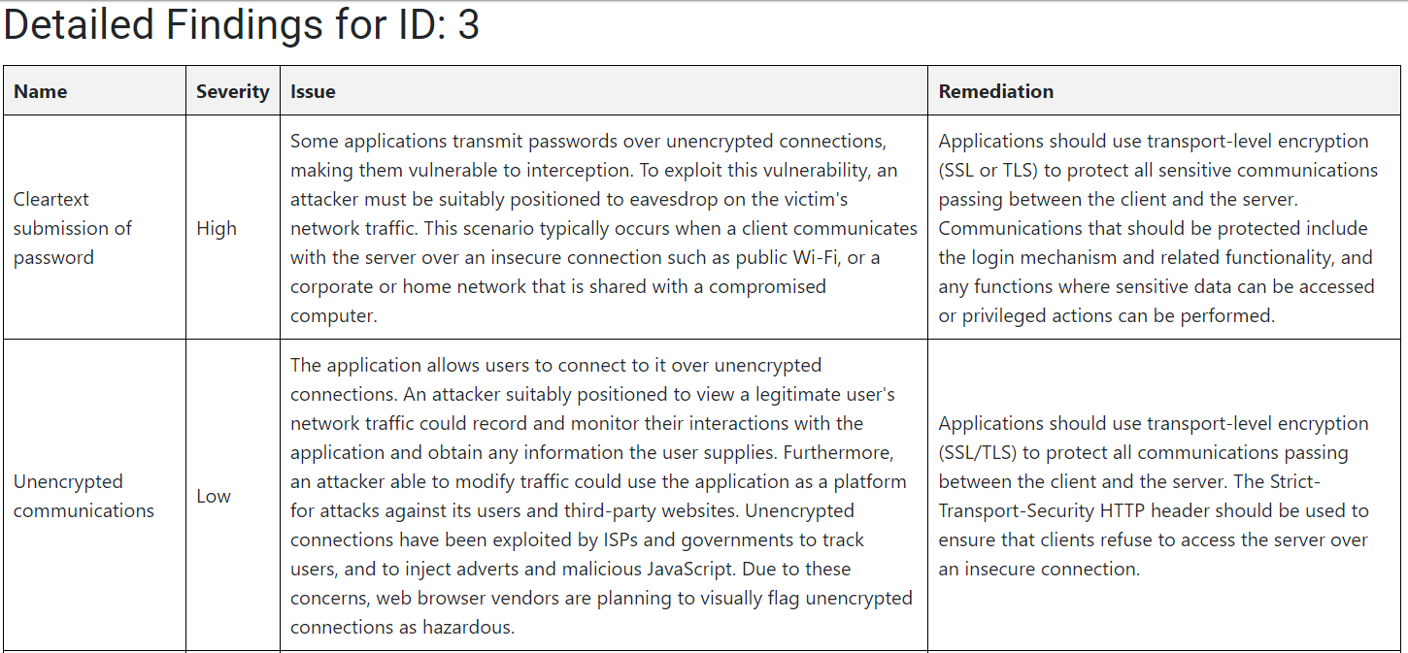
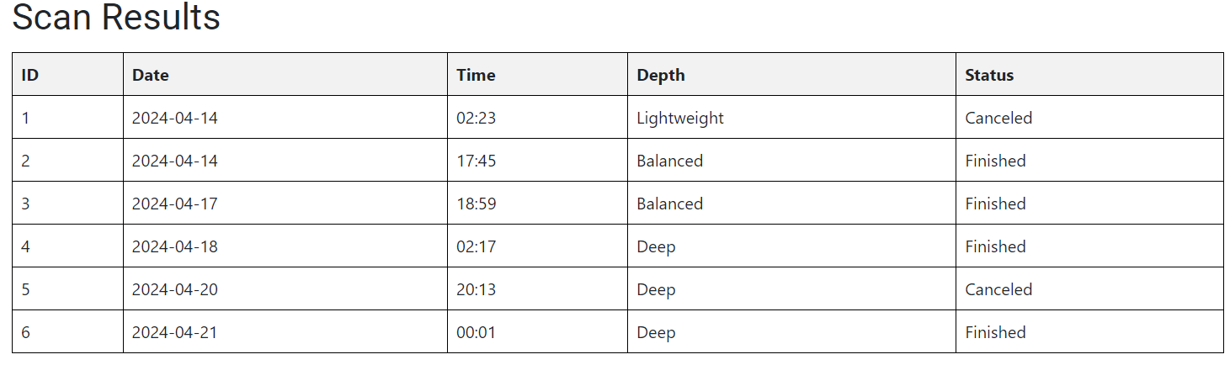
What are we Visualizing?

Slide 8
What are we Visualizing?

Slide 9
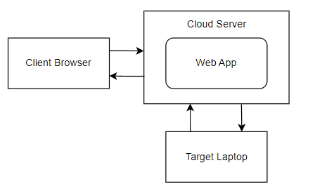
System Architecture

Slide 10
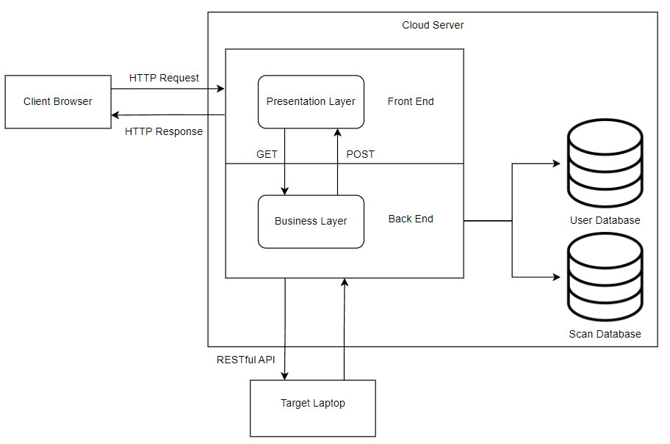
Sub-System Design: Web App

Slide 11
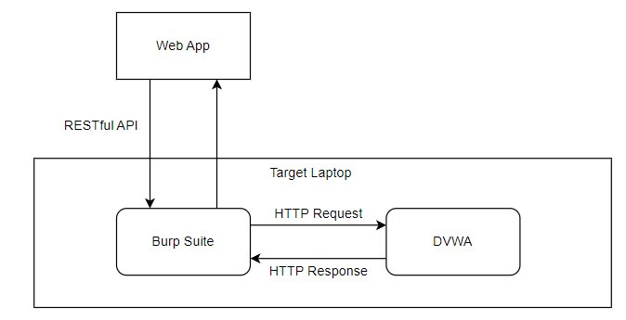
Sub-System Design: Target

Slide 12

DEMO

Slide 13
Summary of Tests and Validation
Test
Validation
Functional:
Atomic tests
Page-by-page
Manual backend calls
Hard-coded troubleshooting
Functions
Ensure meeting expectations

Slide 14
If we were to continue…
More functionality of the User Dashboard
Integrate Other Penetration Testing Tools
Addition of a
Help Chat Bot

Slide 15



Lessons Learned
This Photo by Unknown Author is licensed under CC BY-NC
Documentation
Training
Planning
Mission Statement: Empowering Organization Cybersecurity through the democratization of vulnerability testing​
Vision: A Safer Digital World through more accessible Security​
Core Values: Accessibility, Reliability, User-Centric Design​
​
End Goal: Distribute an online method for companies to easily test their own website vulnerabilities

Slide 16

Q&A

